Slide 1




Slide 2

Test Time Block Swap algorithm
URL : https://forms.gle/oJNdVMtmfUVRQVrs9

Slide 3

MAXIMUM PRODUCT SUBARRAY

Slide 4

TOPICS
Introduction to Maximum Product Subarray
Difference between Subarray and Subsequence
Variants of Maximum Product Subarray
Examples of Maximum Product Subarray
Different Approaches for Maximum Product Subarray
Efficiency Comparison of Maximum Product Subarray
Brute Force Approach - Maximum Product Subarray
Prefix Suffix Approach - Maximum Product Subarray
Dynamic Programming Approach - Maximum Product Subarray
Why DP Approach is Efficient ?
Real-Time Applications of Maximum Product Subarray
Company Questions

Slide 5

Introduction to Maximum Product Subarray
The Maximum Product Subarray problem is a famous array-based interview question frequently asked in both product-based and service-based companies.
In this problem, we need to find the contiguous subarray within a given array that produces the largest product among all possible subarrays.
A subarray is a continuous sequence of elements taken from an array.

Slide 6
Difference between Subarray and Subsequence
What is a Subarray?
A subarray is a continuous part of an array.
Example: Array = [2, 3, -2, 4]
Possible subarrays:
[2, 3]
[3, -2, 4]
[-2]
Here, elements must remain continuous.

Slide 7
Difference between Subarray and Subsequence
What is a Subsequence?
A subsequence is formed by taking elements in the same order but not necessarily continuous.
Example: Array = [2, 3, -2, 4]
Possible subsequences:
[2, -2, 4]
[3, 4]
[2, 4] Elements can be skipped.

Slide 8
Variants of Maximum Product Subarray
We have,
Maximum Product Subarray
Maximum Sum Subarray
Unlike Maximum Sum Subarray (Kadane’s Algorithm), the Maximum product subarray is slightly tricky because:
Negative numbers can turn a small product into a large product.
Zero can reset the product.
We must track both:
Maximum product till current index
Minimum product till current index

Slide 9
Maximum Product Subarray Problem
Problem Statement
Given an integer array of size N, find the contiguous subarray having the maximum product and print the maximum product.
Input Format
The first line contains an integer N representing the size of the array.
The second line contains N space-separated integer array elements.
Output Format
Print the maximum product of the contiguous subarray.

Slide 10
Maximum Product Subarray Problem
Sample Input 1
3
-2 3 -4
Sample Output 1
24
Explanation
The subarray: [-2, 3, -4] gives:
(-2) × 3 × (-4) = 24

Slide 11
Examples of Maximum Product Subarray
1. Basic Positive Numbers
Input
[1, 2, 3, 4]
Maximum Product Subarray
[1, 2, 3, 4]
Output
24
Explanation
All numbers are positive, so multiplying all elements gives the maximum product.
2. Contains Negative Numbers
Input
[2, 3, -2, 4]
Maximum Product Subarray
[2, 3]
Output
6
Explanation
Including -2 reduces the product, so [2,3] gives the maximum product.

Slide 12
Examples of Maximum Product Subarray
3. Two Negative Numbers Become Positive
Input
[-2, 3, -4]
Maximum Product Subarray
[-2, 3, -4]
Output
24
Explanation
Negative × Negative = Positive (-2) × 3 × (-4) = 24
4. Array Contains Zero
Input
[0, 2, -1, 4, 0, 5]
Maximum Product Subarray
[5]
Output
5
Explanation
Zero resets the product calculation.

Slide 13
Examples of Maximum Product Subarray
5. Single Element Array
Input
[-5]
Output
-5
Explanation
Only one element exists, so it becomes the answer.
6. All Negative Numbers (Even Count)
Input
[-1, -2, -3, -4]
Maximum Product Subarray
[-1, -2, -3, -4]
Output
24
Explanation
Even number of negatives gives positive product.

Slide 14
Examples of Maximum Product Subarray
7. All Negative Numbers (Odd Count)
Input
[-1, -2, -3]
Maximum Product Subarray
[-2, -3]
Output
6
Explanation
Removing one negative gives larger positive product.
8. Multiple Zeros
Input
[0, -2, 0, -1, 0]
Output
0
Explanation
Zeros break the subarrays repeatedly.

Slide 15
Different Approaches for Maximum Product Subarray
Brute Force Approach – Check product of all possible subarrays.
Dynamic Programming Approach – Track current maximum and minimum products while traversing.
Prefix and Suffix Product Approach – Calculate products from both directions to handle negatives and zeros.
Kadane’s Algorithm Inspired Approach – Modify Kadane’s logic to work with products instead of sums.
Divide and Conquer Approach – Divide array into parts and combine results recursively.

Slide 16
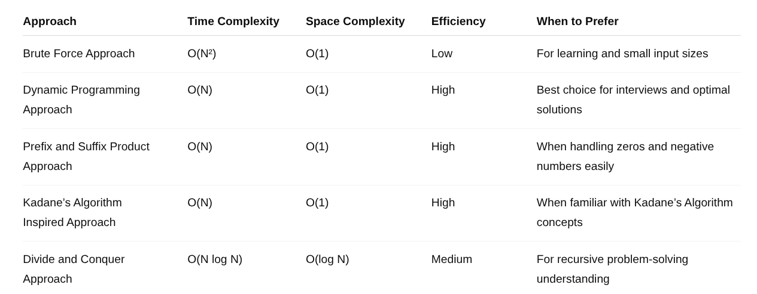
Efficiency Comparison of Maximum Product Subarray

Slide 17
Brute Force Approach - Maximum Product Subarray
Algorithmic Steps
Read the array elements.
Initialize maxProduct with minimum value.
Start outer loop from index 0.
Initialize product as 1.
Start inner loop from current index.
Multiply elements continuously to form subarrays.
Update maximum product if current product is greater.
Print the maximum product.

Slide 18
Brute Force Approach - Maximum Product Subarray
import java.util.Scanner;
public class Main {
public static int maxProduct(int[] arr, int n) {
int maxProduct = Integer.MIN_VALUE;
for (int i = 0; i < n; i++) {
int product = 1;
for (int j = i; j < n; j++) {
product *= arr[j];
maxProduct = Math.max(maxProduct, product);
}
}
return maxProduct;
}
public static void main(String[] args) {
Scanner sc = new Scanner(System.in);
int n = sc.nextInt();
int[] arr = new int[n];
for (int i = 0; i < n; i++) {
arr[i] = sc.nextInt();
}
System.out.println("Maximum Product Subarray: " + maxProduct(arr, n));
}}
Time Complexity : O(N²) Space Complexity : O(1)

Slide 19
Prefix Suffix Approach - Maximum Product Subarray
Algorithmic Steps
Read array elements.
Initialize:
prefix = 1
suffix = 1
maxProduct
Traverse array from left to right for prefix product.
Traverse simultaneously from right to left for suffix product.
Reset prefix or suffix to 1 if product becomes 0.
Update maximum product using prefix and suffix values.
Print final maximum product.

Slide 20
Prefix Suffix Approach - Maximum Product Subarray
import java.util.Scanner;
public class Main {
public static int maxProduct(int[] arr, int n) {
int prefix = 1;
int suffix = 1;
int maxProduct = Integer.MIN_VALUE;
for (int i = 0; i < n; i++) {
if (prefix == 0)
prefix = 1;
if (suffix == 0)
suffix = 1;
prefix *= arr[i];
suffix *= arr[n - i - 1];
maxProduct = Math.max(maxProduct,
Math.max(prefix, suffix));
}
return maxProduct;
}
public static void main(String[] args) {
Scanner sc = new Scanner(System.in);
int n = sc.nextInt();
int[] arr = new int[n];
for (int i = 0; i < n; i++) {
arr[i] = sc.nextInt();
}
System.out.println("Maximum Product Subarray: " + maxProduct(arr, n));
}
}
Time Complexity : O(N) Space Complexity : O(1)

Slide 21
Dynamic Programming Approach - Maximum Product Subarray
Algorithmic Steps
Read array elements.
Initialize:
maxEnding
minEnding
result
Traverse array from index 1.
If current element is negative:
Swap maximum and minimum products.
Update:
Current maximum product
Current minimum product
Update overall maximum product.
Print final answer.

Slide 22
Dynamic Programming Approach - Maximum Product Subarray
import java.util.Scanner;
public class Main {
public static int maxProduct(int[] arr, int n) {
int maxEnding = arr[0];
int minEnding = arr[0];
int result = arr[0];
for (int i = 1; i < n; i++) {
if (arr[i] < 0) {
int temp = maxEnding;
maxEnding = minEnding;
minEnding = temp;
}
maxEnding = Math.max(arr[i],
maxEnding * arr[i]);
minEnding = Math.min(arr[i],
minEnding * arr[i]);
result = Math.max(result, maxEnding);
}
return result;
}
public static void main(String[] args) {
Scanner sc = new Scanner(System.in);
int n = sc.nextInt();
int[] arr = new int[n];
for (int i = 0; i < n; i++) {
arr[i] = sc.nextInt();
}
System.out.println("Maximum Product Subarray: " + maxProduct(arr, n));
}
}

Slide 23
Time and Space Complexity - DP Approach
Time Complexity: O(N)
Array is traversed only once.
Each element is processed in constant time.
Space Complexity: O(1)
Uses only a few variables.
No extra array or data structure is used.
Time Complexity : O(N) Space Complexity : O(1)

Slide 24

Why DP Approach is Efficient ?
Handles negative numbers efficiently.
Works correctly even with zeros.
Finds answer in a single traversal.
Uses constant extra memory.
Best approach for interviews and coding platforms.

Slide 25
Real-Time Applications of Maximum Product Subarray
Stock market analysis → Finding maximum profit growth period
Business analytics → Identifying highest revenue product sequence
Signal processing → Detecting strongest continuous signal pattern
Image processing → Finding maximum intensity region
Machine learning → Optimization feature multiplication values
Financial forecasting → Analyzing compound growth intervals
Bioinformatics → Protein/DNA sequence pattern analysis
Sensor data analysis → Detecting maximum multiplication trends

Slide 26
AI Sensor Multiplication Pattern
Problem Statement
An AI-based monitoring system stores sensor readings. Some readings are negative due to calibration errors. Find the contiguous segment producing the highest multiplication effect.
Sample Input Format
First line represents the size of array N
Second line represents N space-separated integer elements
Sample Output Format
Print the maximum product subarray value
Asked in Microsoft (2026)

Slide 27

Company Questions - AI Sensor Multiplication Pattern
Sample Input
7
-2 -3 0 -2 -40 5 -1
Sample Output
400
Explanation
Subarray [-2, -40, 5]
(−2)×(−40)×5=400

Slide 28
Java Code - AI Sensor Multiplication Pattern
import java.util.*;
public class SensorAnalysis {
public static void main(String[] args) {
Scanner sc = new Scanner(System.in);
int n = sc.nextInt();
int[] arr = new int[n];
for(int i = 0; i < n; i++) {
arr[i] = sc.nextInt();
}
int maxProduct = arr[0];
int minProduct = arr[0];
int answer = arr[0];
for(int i = 1; i < n; i++) {
if(arr[i] < 0) {
int temp = maxProduct;
maxProduct = minProduct;
minProduct = temp;
}
maxProduct = Math.max(arr[i], maxProduct * arr[i]);
minProduct = Math.min(arr[i], minProduct * arr[i]);
answer = Math.max(answer, maxProduct);
} System.out.println(answer);
}}
Time Complexity: O(N)
Space Complexity: O(1)

Slide 29
Investment Risk Chain
Problem Statement
A financial firm stores percentage gain/loss values for investments.
Find the continuous investment chain producing the maximum compounded multiplication value.
Sample Input Format
First line represents the size of array N
Second line represents N space-separated integer elements
Sample Output Format
Print the maximum product subarray value
Asked in Goldman Sachs (2025)

Slide 30
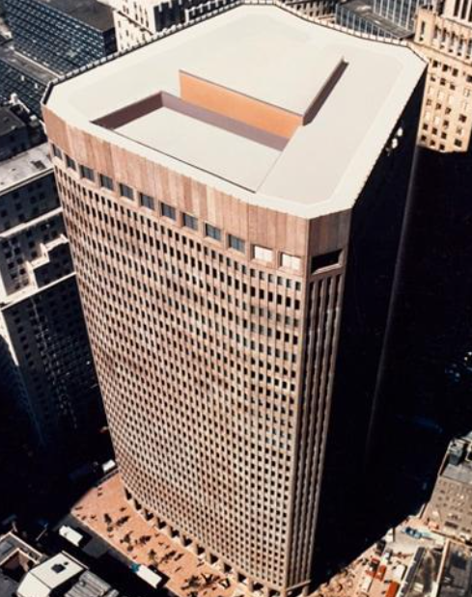
Investment Risk Chain
Sample Input
6
1 -2 -3 4 -1 2
Sample Output
48
Explanation
Subarray [-2, -3, 4, -1, 2]
(−2)×(−3)×4×(−1)×2 = 48

Slide 31
Java Code - Investment Risk Chain
import java.util.*;
public class InvestmentAnalysis {
public static void main(String[] args) {
Scanner sc = new Scanner(System.in);
int n = sc.nextInt();
int[] arr = new int[n];
for(int i = 0; i < n; i++) {
arr[i] = sc.nextInt();
}
int maxVal = arr[0];
int minVal = arr[0];
int result = arr[0];
for(int i = 1; i < n; i++) {
int current = arr[i];
int tempMax = Math.max(current,
Math.max(maxVal * current,
minVal * current));
minVal = Math.min(current,
Math.min(maxVal * current,
minVal * current));
maxVal = tempMax;
result = Math.max(result, maxVal);
}
System.out.println(result);
}}
Time Complexity: O(N)
Space Complexity: O(1)

Slide 32
Interview questions
Asked in Amazon (2025) - MCQ
What is the time complexity of the optimal solution?
A) O(N²) B) O(log N) C) O(N) D) O(N log N)
Answer: C) O(N)

Slide 33
Interview questions
Asked in Amazon OA (2026) - MCQ
Which algorithm is most similar to this problem?
A) Binary Search B) Merge Sort C) Kadane’s Algorithm D) BFS
Answer: C) Kadane’s Algorithm

Slide 34

Interview questions
Explain the Maximum Product Subarray problem.
The Maximum Product Subarray problem involves finding a contiguous subarray within an array that has the largest product of its elements.

Slide 35
Interview questions
How would you approach solving the Maximum Product Subarray problem?
One common approach is to use dynamic programming. We can keep track of both the maximum and minimum product subarrays at each index while iterating through the array. By considering the maximum of four cases for each element, we update the maximum and minimum subarray products. Finally, we return the maximum product found.

Slide 36
Interview questions
What is the time complexity of the Maximum Product Subarray algorithm?
The time complexity of the algorithm is O(n), where n is the size of the input array. This is because we iterate through the array only once, performing constant time operations at each index.

Slide 37
Interview questions
How can we handle edge cases in the Maximum Product Subarray problem?
One possible edge case is an empty array. In such cases, we can return 0 as there are no elements to consider.
Another edge case is when the array has only one element. In this case, the maximum product subarray would be that single element.

Slide 38


Help Desk
Any concerns related to attendance/marks/ faculty ; you can reach out to ETHNUS helpdesk through the displayed QR code
https://codemithra.com/vit-helpdesk/

Slide 39

https://learn.codemithra.com

Slide 40




THANK YOU
+91 78150 95095
codemithra@ethnus.com
www.codemithra.com

